Slide 1
Listening Skill Levels of Listening Types of Listening
Functional English
Week 10

Slide 2
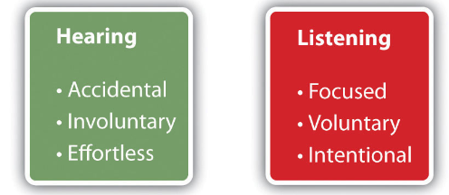
Hearing vs Listening
Hearing
a natural ability to detect sound
physiological process of attending to sound within one’s environment
Listening
a skill which is developed to understand or interpret the message accurately.

Slide 3
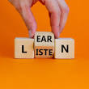
Introduction
The process of receiving, constructing meaning from, and responding to a spoken and/ or non-verbal message.
Listening is key to all effective communication, without the ability to listen effectively messages are easily misunderstood – communication breaks down and the sender of the message can easily become frustrated or irritated.

Slide 4
Listening ability vary according to
Interest in topic
the delivery of the message
importance of the information
length of the message
complexity of the message
the delivery of the message
personal problems, external distraction.

Slide 5

Levels of Listening

Slide 6
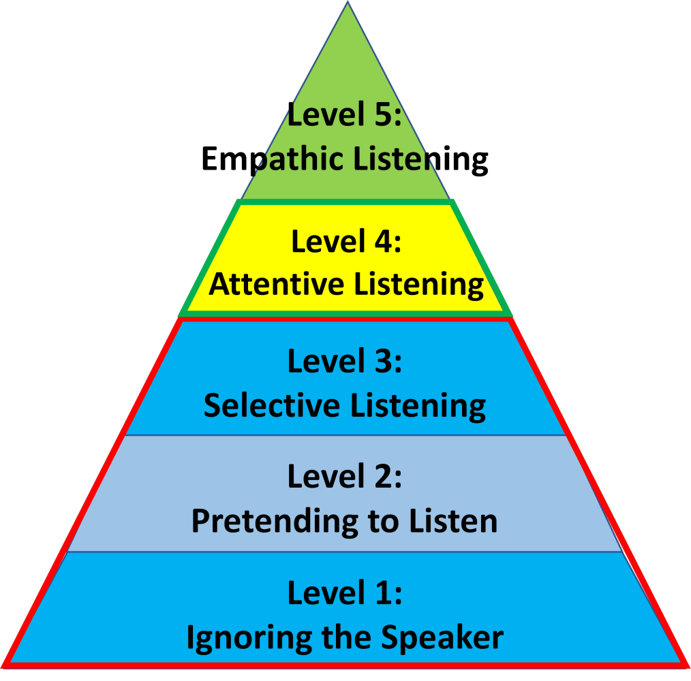
5 Levels of Listening
Each level represents the degree to which someone listens to another person during a conversation.
Stephen R. Covey's Listening Continuum identifies five(5) levels of listening
Notes:
Levels of Listening explores how important listening is for effective communication.
most of our efforts to develop communication skills deals with reading, writing and speaking. But very little effort is placed on developing our ability to really hear the other person's perspective.

Slide 7

Level 1 Ignoring
Ignoring is the most basic level of listening.
when we expend zero effort to listen.
we aren’t really listening at all
making an effort to avoid the conversation entirely
this level can frustrate the person you are speaking to

Slide 8
Level 2 Pretending to Listen
Pretend listeners give you the impression they hear what you say, and they may hear some of your words, but they are not "present."
They may nod their head or offer another gesture to indicate they are listening, but they are not giving you their full attention.
For example, if your boss is giving you important project details on a Zoom call while you nod and smile, you are simultaneously sending funny messages to your friend about something irrelevant, you probably pretend listening.

Slide 9

Level 3 Selective Listening
The person who listens selectively only wants part of the message, but not all.
They are probably the person who says, "So, what's your point?”
They are quick to interrupt the person who is speaking or they have the tendency to finish the other person's sentences.

Slide 10
Level 4 Attentive Listening
Attentive/ active listening is taking a moment !
Pay (attention), pause, process, respond.
using the right body language to show that we are listening.
But they are one step short of being empathic listeners because attentive listeners hear from their frame of reference.
They don't try to put themselves in the other person's shoes.

Slide 11
Level 5 Empathic Listening
concentrate and listen to understand the intent behind the message
The person who develops this skill listens not only to the other person's words, but also listens for what the other person means.
willing to give their time AND full attention to truly hear the other person.
"To truly listen means to transcend your autobiography, to get out of your own frame of reference, out of your own value system, out of your own history and judging tendencies, and to get deeply into the frame of reference or viewpoint of another person. This is called empathic listening. It is a very, very rare skill. But it is more than a skill. Much more." - Stephen R. Covey, The 8th Habit

Slide 12
Case Study
In a school in Islamabad, Mrs. Ahmed delivered a lecture on the Industrial Revolution to her 10th-grade class. While most students participated actively, Hassan, seated at the back, was distracted, doodling instead of taking notes. Despite her emphasis on key points like technological advancements and societal changes, Hassan was occasionally looking up when the teacher raised her voice to emphasize an important point. When asked to summarize the lecture, he struggled to provide a coherent response. He muttered something about factories and machines, but it was evident that he hadn’t fully absorbed the information However, when another student brought up modern automation's impact on jobs, Hassan showed interest and gave insightful input on modern technology, revealing his limited engagement during the lecture.
What level of listening did Hassan exhibit during Mrs. Ahmed's lecture?
What were the consequences of Hassan’s limited engagement during the lecture?
What strategies can be recommended to help Hassan improve his listening during lectures?
Notes:
Discuss that this sort of case studies can be part of exam too.

Slide 13
Possible Answers
What level of listening did Hassan exhibit during Mrs. Ahmed's lecture?
Hassan demonstrated selective listening, as he only responded to the parts of the lecture related to modern technology but ignored the rest.
What were the consequences of Hassan’s limited engagement during the lecture?
The consequence of Hassan’s limited listening was his inability to provide a coherent summary of the lecture, showing he missed the key points discussed.
What strategies can be recommended to help Hassan improve his listening during lectures?
To improve, Hassan should practice active listening, take notes, and participate in discussions to engage with the content fully.

Slide 14
Types of Listening

Slide 15
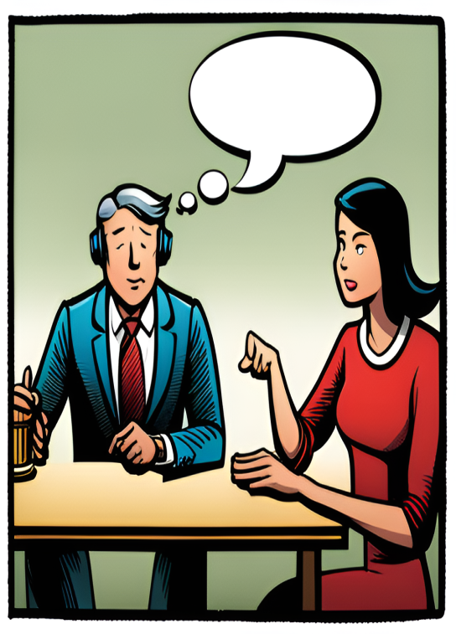
Types of Listening
Appreciative listening
Informational listening
Critical Listening
Empathetic listening
Listening types can be defined by the goal of the listening.

Slide 16

1. Appreciative Listening
it involves listening for the sake of enjoyment
listening for pleasure
require very little active listening because the stakes are low
Examples
listening to a favorite song, poetry, stories, comedy shows etc.

Slide 17
2. Informational Listening
listening to learn
this is true in many day-to-day situations, in education and at work
require concentration and conscious effort to understand
does not involve analysis and criticism
Example
when you listen to the news, watch a documentary, when a friend tells you a recipe or when you are talked-through a technical problem with a computer, listening to teacher to learn

Slide 18
It occurs when one listens for sake of analyzing, critiquing
making judgements about the speaker or the message
helps in analyzing complex information
can also help determine truth from opinion and facts from feelings when implemented well
Example
problem-solving, multiple options, various perspectives, helps sort the options
3.
Critical Listening

Slide 19
4. Empathetic Listening
It is beyond active listening
to understand feeling and emotion of the speaker
making an emotional connection with the other person and finding similarities between their experience and your own so you can give a more heartfelt response.
can make it difficult to maintain a sense of objectivity
Example:
Comforting a friend
Providing Emotional support
Therapist talking to client/patient
Notes:
paying attention to their words and nonverbal cues, and reflecting on what they say to truly understand their perspective

